Slide 1
Professional Dress Guidelines
Women

Slide 2
Professional appearance is an important aspect of the overall preparation of BPA members for the business world. So students represent Oklahoma BPA and the National BPA Association in a professional and business-like manner with the highest of professional standards this dress code has been established.
It is the responsibility of the chapter advisors to ensure students adhere and comply with the established dress code. Students, advisors, and chaperones must follow the dress code.

Slide 3
Oklahoma BPA does not require the official BPA blazer for competition, and students not wearing the official BPA blazer will not be penalized during any competition. However, strict adherence to these guidelines is mandatory for conference attendees while attending conference functions. These functions include, but are not limited to: competitions, official BPA meetings, and award ceremonies.

Slide 4
There are two divisions of dress code: Professional Dress and Business Casual. Professional dress is required while competing, while on stage, or attending any official Oklahoma BPA meeting or event. Business Casual is designed for any time other than when professional dress is required. While on conference property students are required to adhere to this dress code at all times. When students are not competing, presenting, or attending an official Oklahoma BPA function they must still dress in a manner that is appropriate representation of Oklahoma BPA. Students not adhering to or in question of this official dress code policy will not be allowed on stage to receive an award. All decisions are final by state staff regarding dress code. Judges will assess each contestant’s dress during competition. The student will have a point deduction for not following the appropriate dress code.

Slide 5
Local advisors, please review this dress code with your students prior to attending the conference. Oklahoma BPA wants every student to have the opportunity to succeed and be recognized on stage, but students will be denied the privilege to attend events and appear on stage if they are dressed inappropriately.
Important!

Slide 6
Professional Dress
Guidelines
Competition
On Stage
Official Oklahoma BPA Events

Slide 7
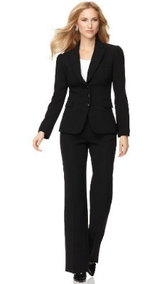
Pant Suit
Acceptable

Slide 8
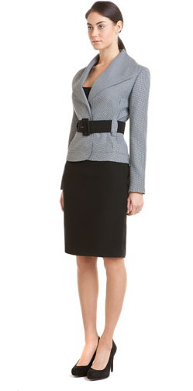
Skirt Suit
Acceptable

Slide 9
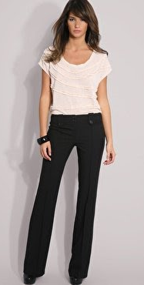
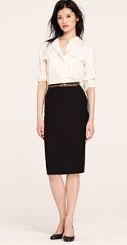
Coordinated
Acceptable

Slide 10
Skirts must be an appropriate length - No more than 2 inches above the knee!

Slide 11
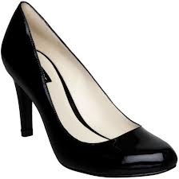
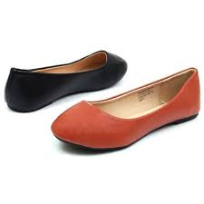
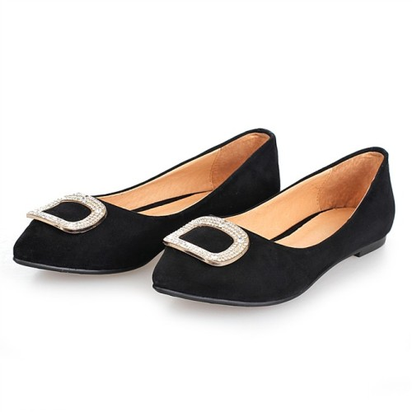
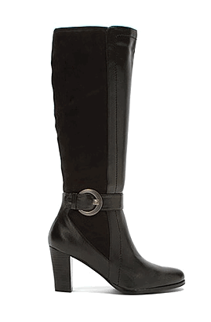
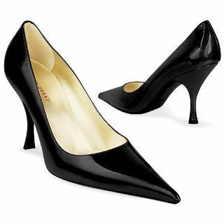
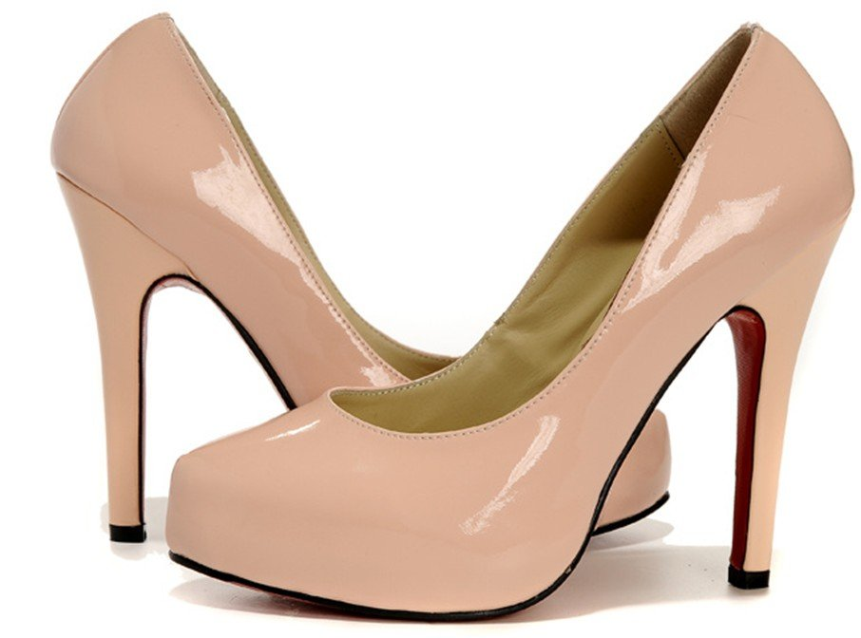
Shoes
Acceptable

Slide 12
A good rule of thumb when it comes to shoes-
Nothing over-the-top, keep it simple, neutral, and classy.

Slide 13
Unacceptable
Attire

Slide 14
Unacceptable
Skin tight or revealing clothing is not business professional.

Slide 15
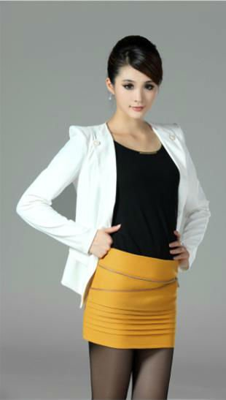
Unacceptable
Skirts and dresses cannot be more than
2 inches above the knee.

Slide 16
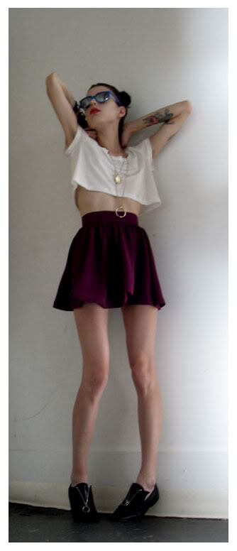
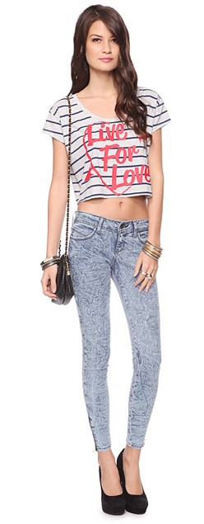
Unacceptable
Midriff clothing is not considered business professional

Slide 17
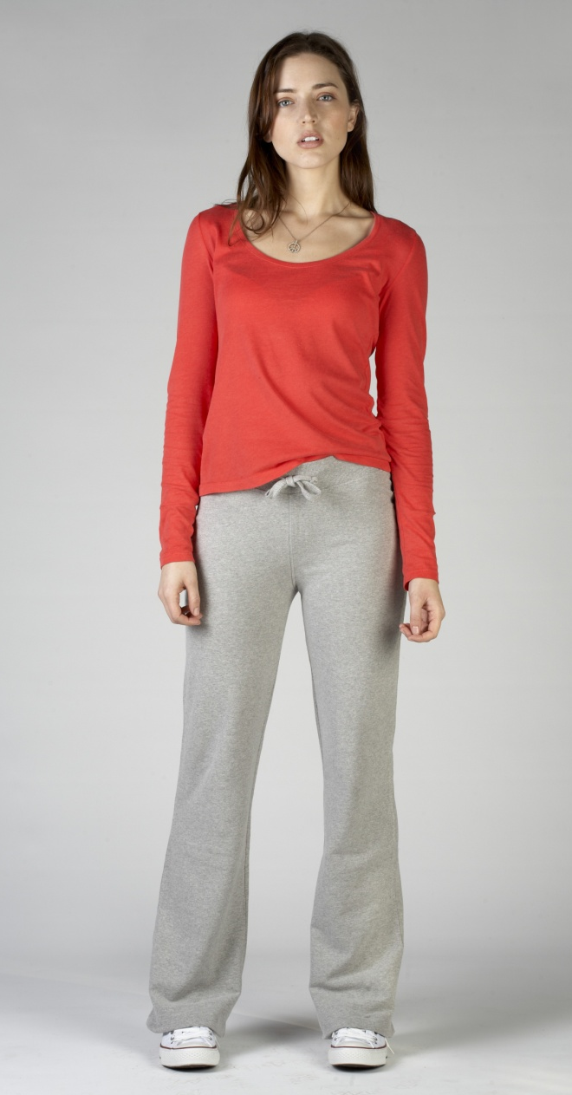
Unacceptable
Athletic clothing is not business professional.

Slide 18
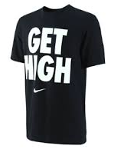
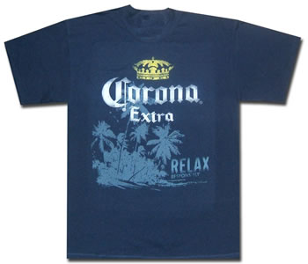
Unacceptable
Clothing that is suggestive, obscene, or promotes illegal substances will not be tolerated.

Slide 19
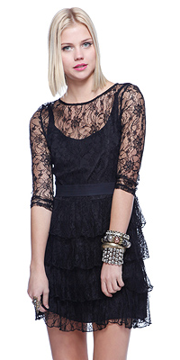
Unacceptable
See-through clothing is not considered business professional

Slide 20
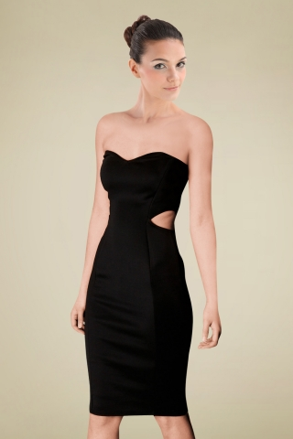
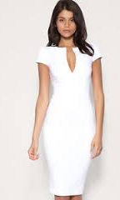
Unacceptable
Strapless, low cut shirts, or shirts with cut outs
Is not considered business professional.

Slide 21
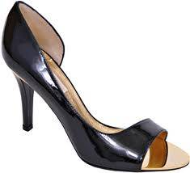
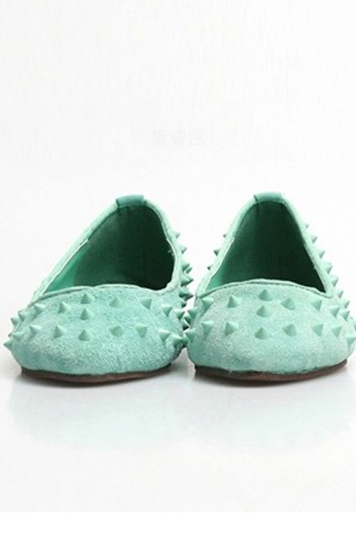
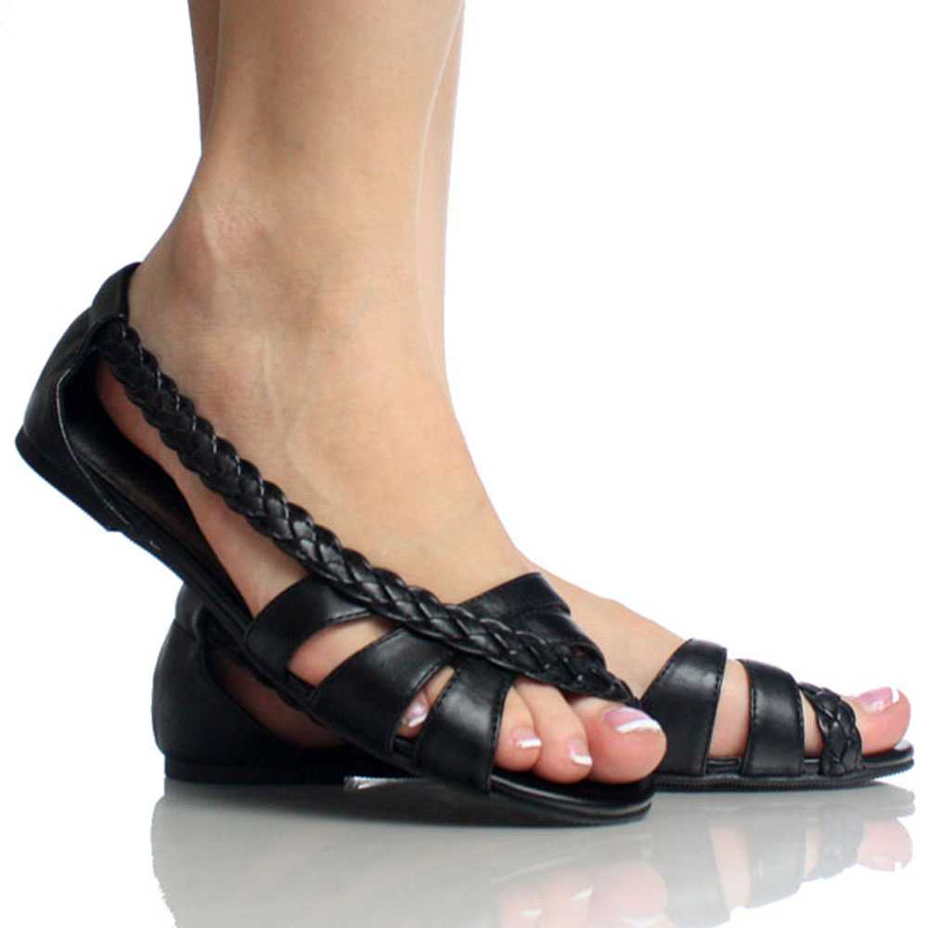
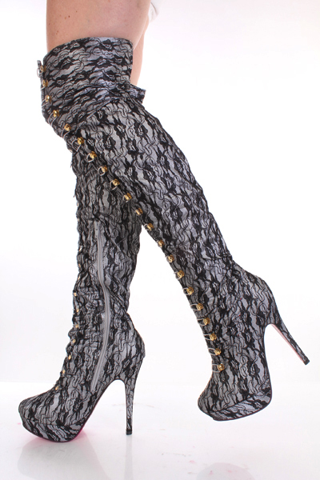
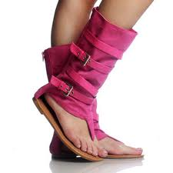
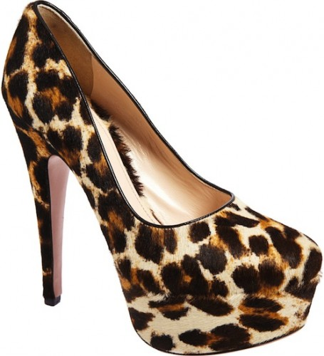
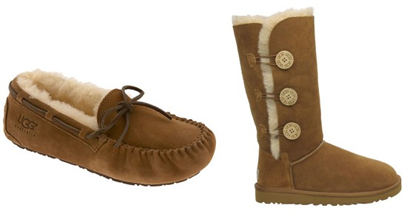
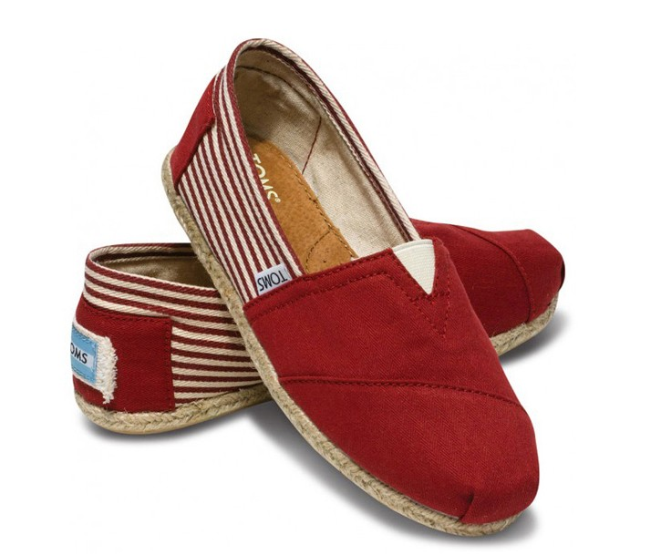
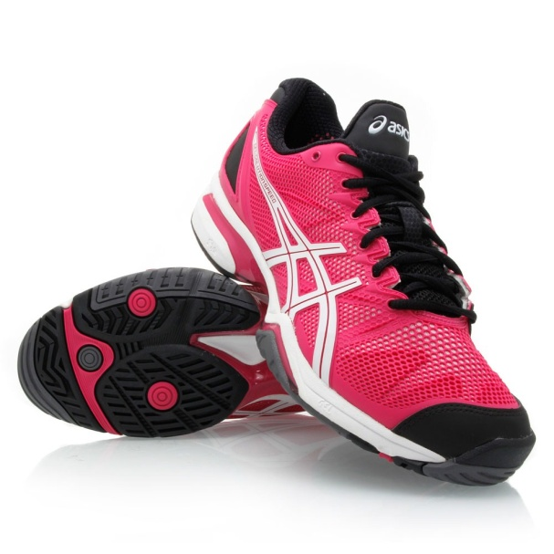
Unacceptable

Slide 22
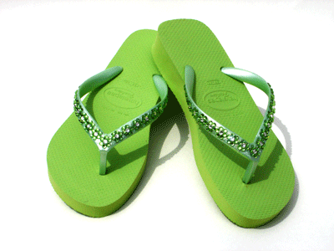
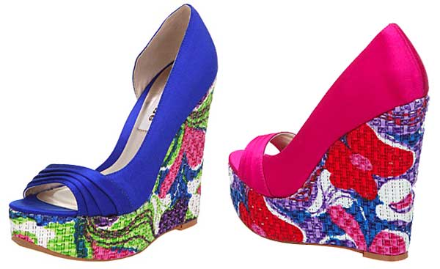
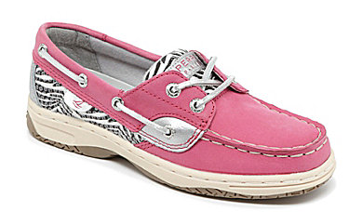
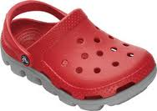
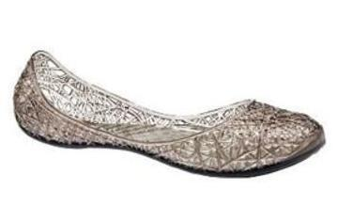
Unacceptable
Unacceptable Shoes:
Flip Flops
Open Toe
Open Heel
Boat Shoes
Canvas Shoes
Platform Heels
Tennis Shoes
Casual Shoes
Studded Shoes
Slingbacks
Inappropriately High Boots

Slide 23
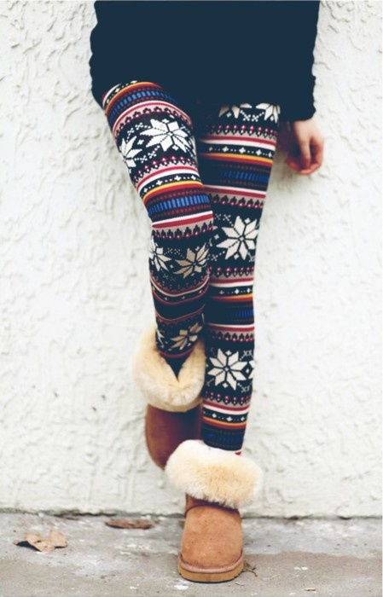
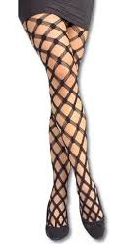
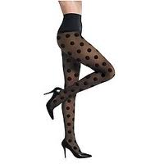
Unacceptable
Baggy pants, leggings, patterned tights, and fishnet are not allowed.
Pants must be worn at the waist.

Slide 24
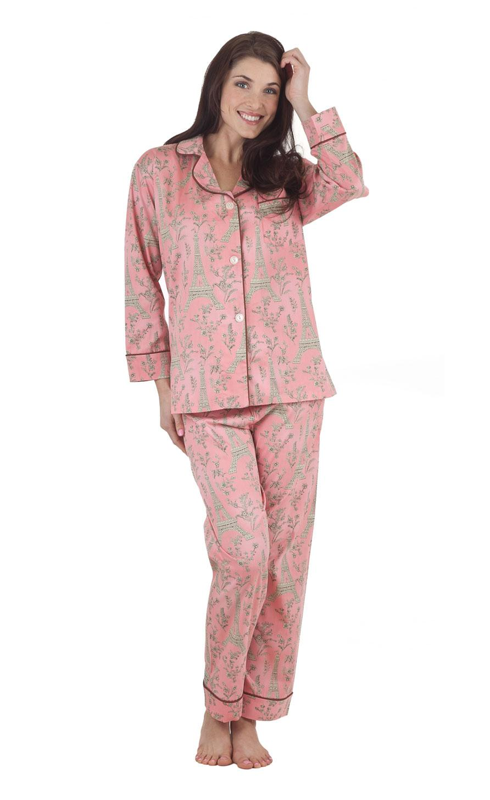
Unacceptable
Swimwear and sleepwear are not allowed.

Slide 25
Unacceptable
Denim is not allowed at competition, on stage, or at any official BPA event.

Slide 26
Everyone wants to look cute, but sometimes looking cute is not the same as looking professional.

Slide 27
Be conservative and use discretion.

